Slide 1
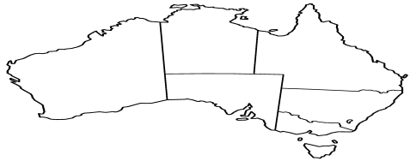
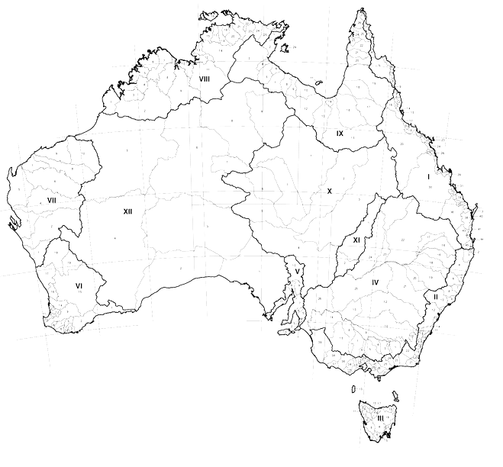
Hierarchical Relationship:
- e.g., NSW (State) is parent to Albury (LGA)
FSDF
Jurisdictional Units
Spatial Relationship
– e.g. NSW (State) is “adjacent” to Towong (LGA)
Topology
+
Spatial Relationship
Local Government Units
Spatial Relationship
– e.g. Towong (LGA) “intersects” Yackandandah (SA2)
Spatial
Relationship (intra-datasets)
Statistical Units
PSMA
Geometrical
Representation
ABS
Geometry Data

Slide 2
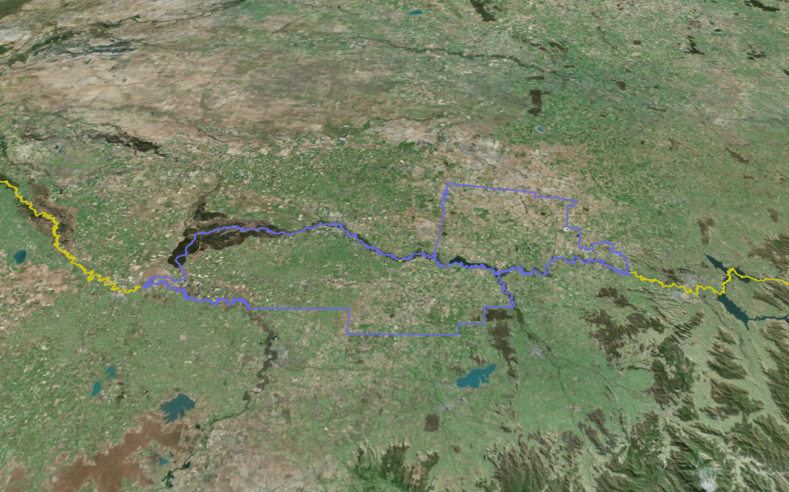
STATE
(NSW)
LGA Y (Corowa)
LGA X
(Moira)
STATE
(VIC)
Adjacent:
LGA X adjacent to LGA Y
State NSW adjacent to State VIC
LGA X adjacent State NSW

